Slide 1
Food Waste Reduction in Urban Areas
(SDG 12 : Responsible Consumption and Production)

Slide 2
PRESENTED BY
SHRAVYA VERMA

Slide 3
OVERVIEW
• Introduction •Objectives • Problem statement • Significance of the problem and relevant SDGs • Data collection • Data description • Data processing & transformation • Data Analysis • Key findings • Solution design and implementation plan • Data visualizations •Conclusion and future ideas • Tools and references

Slide 4
INTRODUCTION
OVERVIEW OF THE PROJECT
Food waste is a significant problem in many urban areas, contributing to environmental degradation and economic loss. This project aims to investigate food waste patterns and propose solutions to minimize waste in cities. By employing data analysis techniques, the project seeks to align with the United Nations Sustainable Development Goals (SDG), specifically focusing on responsible consumption and production (SDG 12).
Through comprehensive data analysis, we will identify the key factors contributing to food waste in urban settings. Predictive models will be developed to forecast future waste patterns and assess the effectiveness of proposed interventions. Actionable solutions, including policy recommendations and community engagement strategies, will be formulated to address the root causes of food waste.

Slide 5
OBJECTIVES
Collect and analyze food waste data from reliable sources.
Identify primary contributors to food waste in urban areas.
Understand temporal and spatial trends in food waste generation.
Develop predictive models to forecast future food waste.
Propose actionable solutions and policy recommendations.
Evaluate the potential impact of these solutions on achieving SDG 12.

Slide 6
PROBLEM STATEMENT
Urban regions face mounting challenges with food waste due to population growth, consumer habits, and inadequate waste management systems. This leads to unnecessary resource use, greenhouse gas emissions, and economic inefficiencies. Despite ongoing efforts, effectively reducing food waste remains difficult due to the lack of comprehensive data and actionable insights. This project intends to analyze food waste data to identify key factors and trends, aiming to develop targeted strategies to mitigate food waste in urban environments.

Slide 7
SIGNIFICANCE OF THE PROBLEM
Food waste is a pressing issue in urban areas, leading to substantial environmental and economic repercussions. It contributes to greenhouse gas emissions, resource depletion, and significant financial losses for both households and businesses.
Reducing food waste is crucial for improving food security, conserving resources, and achieving sustainable development.
RELEVANT SGDs
Addressing this problem aligns with the United Nations Sustainable Development Goal 12, which aims to ensure responsible consumption and production patterns. By tackling food waste, cities can mitigate their environmental footprint, enhance economic efficiency, and promote a more sustainable and equitable food system.

Slide 8
DATA COLLECTION
SOURCES OF DATA: The project will utilize food waste datasets from the following sources:
Kaggle: Various food waste datasets are available on Kaggle, including:
- “Food Waste Data”
- “Food Demand Forecasting”
- “Grocery Store Food Waste”

Slide 9
DATA DESCRIPTION
- Country: Name of the specific country.
- Combined figures (kg/capita/year): Total food wasted per capita annually (households, retail, food service).
- Household estimate (kg/capita/year): Food wasted per capita at households annually.
- Household estimate (tonnes/year): Total food wasted by households annually.
- Retail estimate (kg/capita/year): Food wasted per capita from retail stores annually.
- Retail estimate (tonnes/year): Total food wasted from retail sources annually.
- Food service estimate (kg/capita/year): Food wasted per capita at food service establishments annually.
- Food service estimate (tonnes/year): Total food wasted at food service establishments annually.
- Confidence in estimate: Reliability of the estimates (e.g., low to high).
- M49 code: Numeric code for classifying countries/regions.
- Region: Geographical area or region of the country.

Slide 10
DATA PROCESSING & TRANSFORMATION
DATA CLEANING METHODS:-
Check for Null Values: Identify and handle missing data by imputing or removing incomplete records.
Remove Repeated Values: Eliminate redundancy by identifying and removing duplicate entries.
Rename Columns: Rename columns for better clarity and ease of understanding.

Slide 11
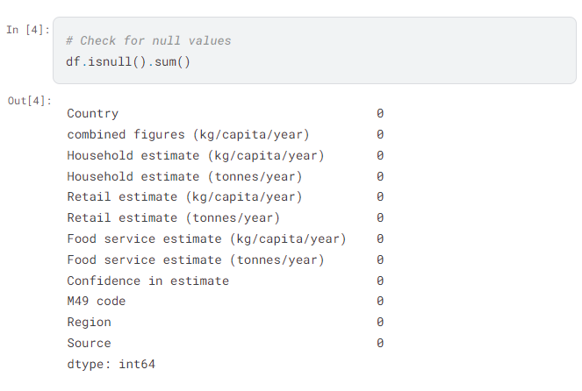
HANDLING MISSING VALUES

Slide 12
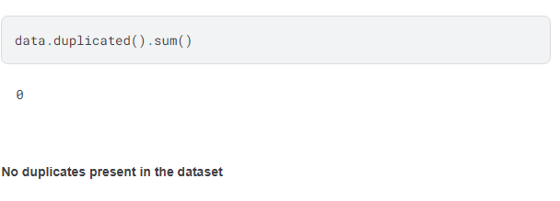
REMOVING REPEATED VALUES

Slide 13
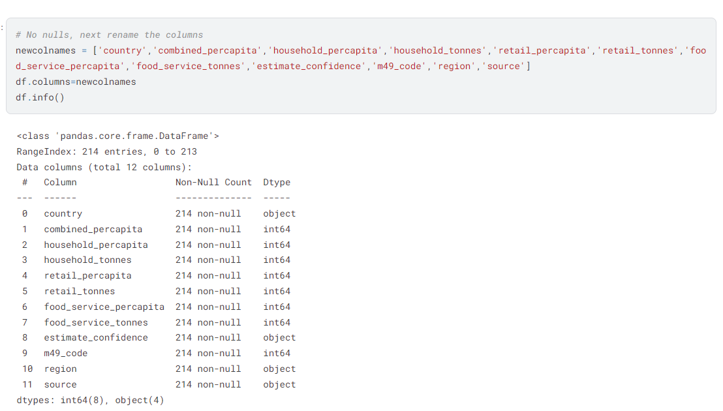
RENAMING COLUMNS

Slide 14
DATA ANALYSIS
ANALYTICAL TOOLS USED:-
Jupyter Notebook: An interactive computing environment for writing and running code, visualizing data, and documenting analysis.
Python Libraries:
Pandas: For data manipulation and analysis.
NumPy: For numerical computations.
Matplotlib/Seaborn: For data visualization.
Scikit-Learn: For machine learning and predictive modeling.
Statsmodels: For statistical analysis and hypothesis testing.

Slide 15
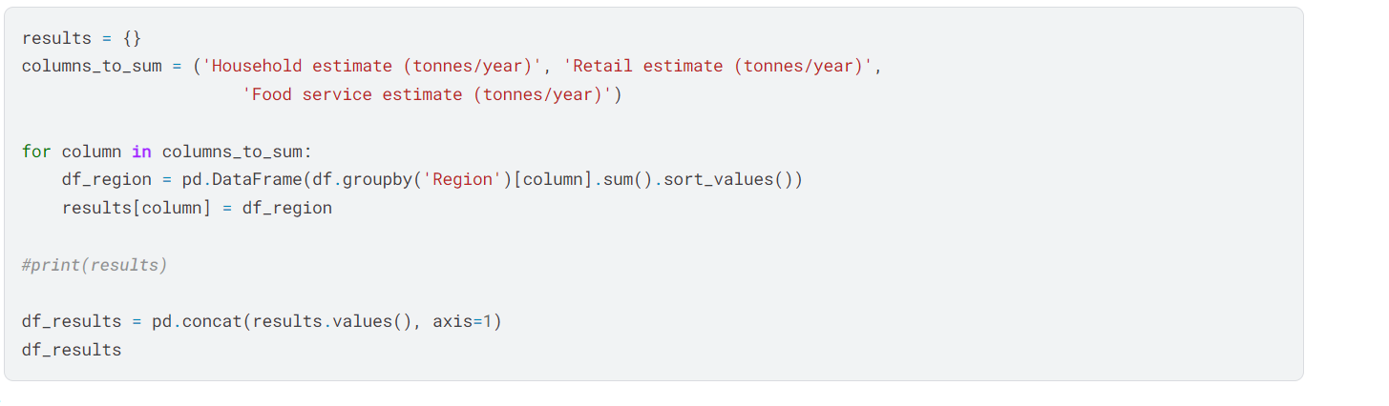
KEY FINDINGS:
Which region of the world wastes the most food ?

Slide 16
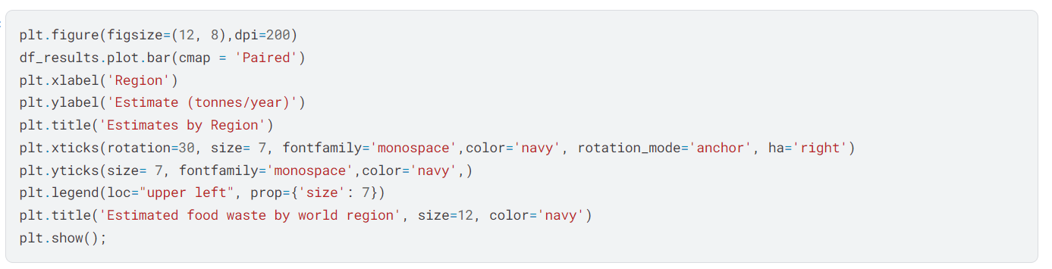

Slide 17
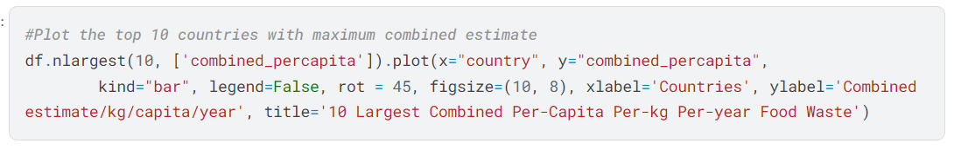
TOP 10 AND BOTTOM 10 COUNTRIES THAT WASTE FOOD

Slide 18
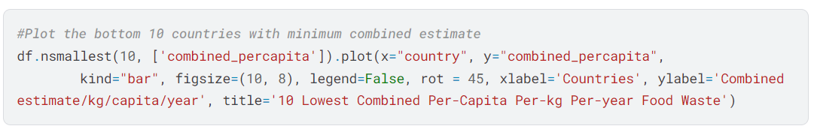

Slide 19
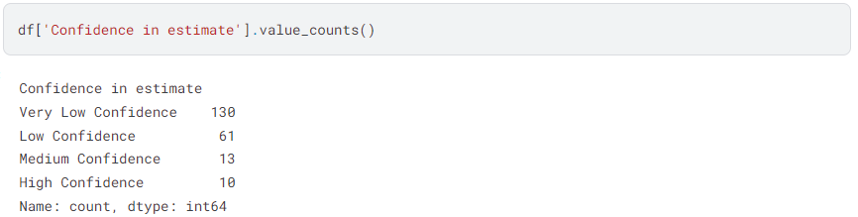
ANALYSIS BASED ON THE CONFIDENCE IN ESTIMATE (DATA RELIABLENESS )

Slide 20
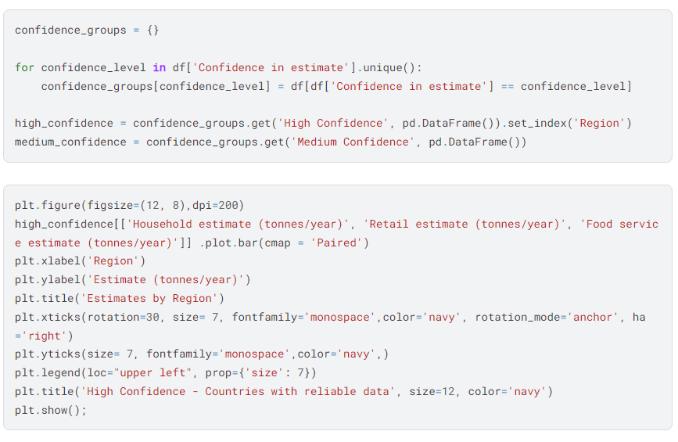

Slide 21
SOLUTION DESIGN
Based on the insights from the predictive models, several actionable solutions can be recommended:
- Enhanced Inventory Control: Introducing advanced inventory tracking systems to minimize overstocking and reduce spoilage.
- Public Awareness Initiatives: Rolling out educational campaigns to inform consumers about effective food storage and portion management.
- Supply Chain Efficiency: Improving collaboration between suppliers and retailers to decrease waste throughout transportation and storage processes.

Slide 22
IMPLEMENTATION PLAN
Objective: Reduce food waste through inventory control, public awareness, and supply chain efficiency.
1. Enhanced Inventory Control
- Assessment: Review current practices; identify issues.
- Technology: Implement advanced tracking systems.
- Training: Educate staff on new systems.
- Monitoring: Regularly track and evaluate inventory data.

Slide 23
2. Public Awareness Initiatives
- Campaigns: Launch educational programs on food storage and portion control.
- Engagement: Use social media and community events to spread awareness.
3. Supply Chain Efficiency
- Collaboration: Improve coordination between suppliers and retailers.
- Optimization: Streamline transportation and storage to reduce waste.
- Monitoring: Track supply chain performance and make necessary adjustments.

Slide 24
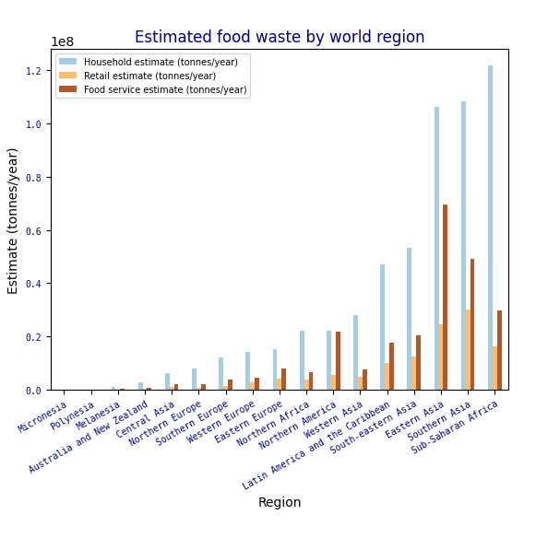
DATA VISUALISATIONS:

Slide 25
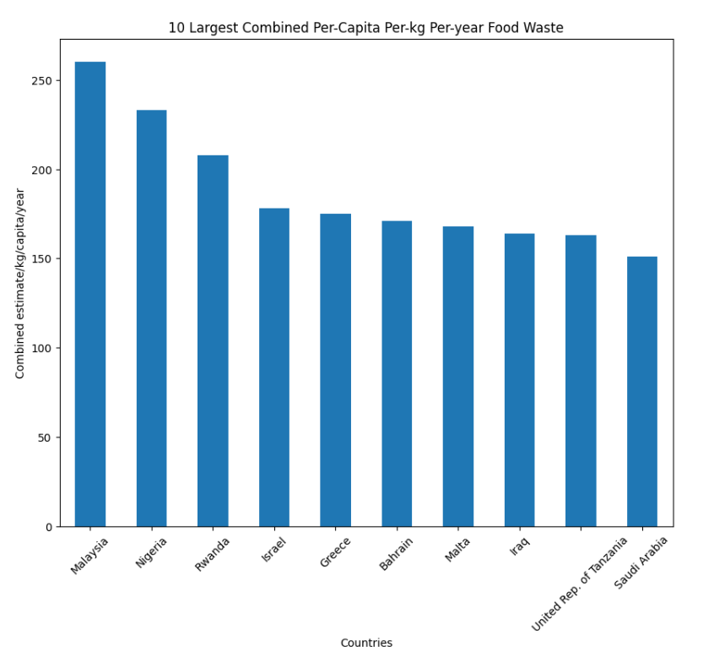

Slide 26
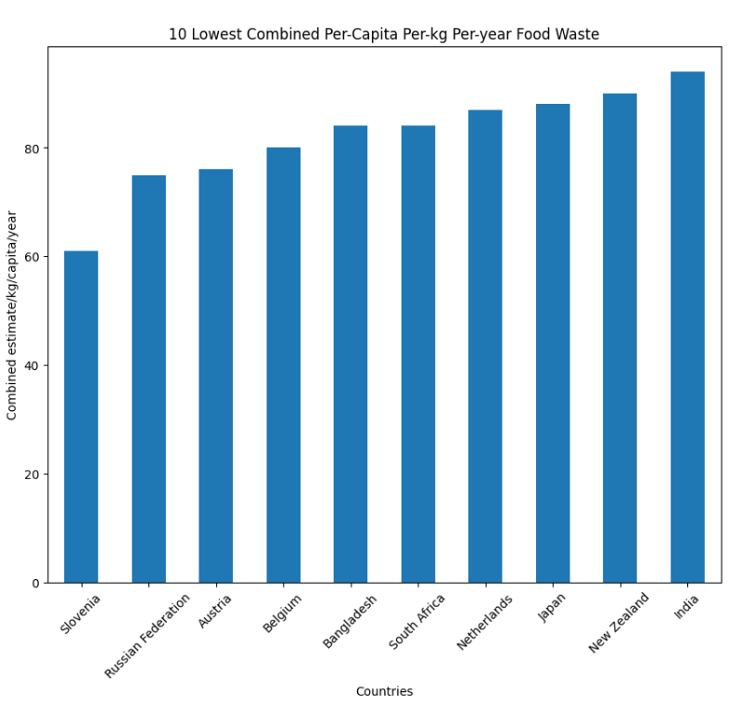

Slide 27
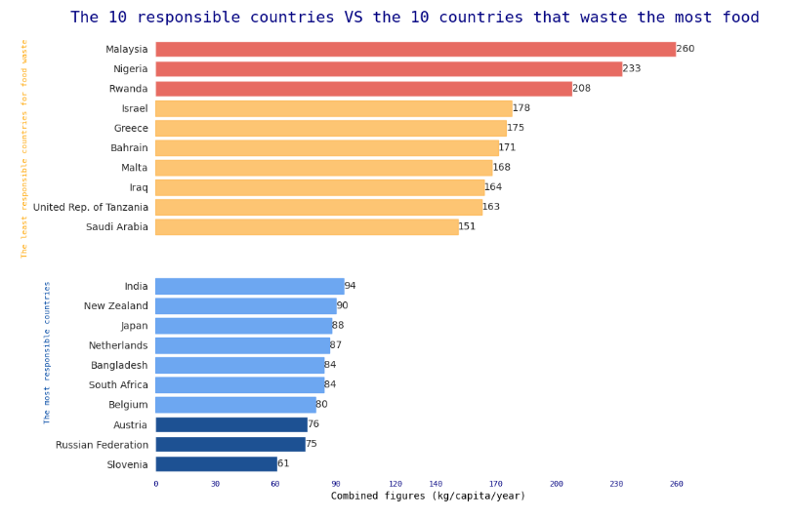

Slide 28
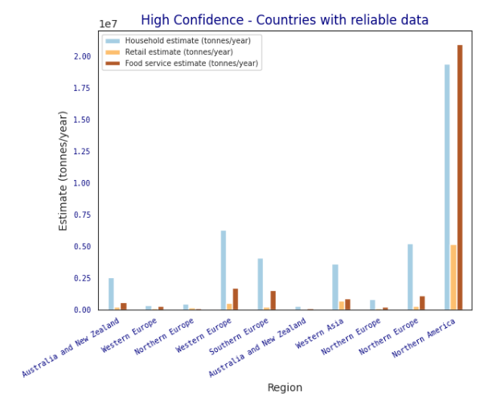

Slide 29
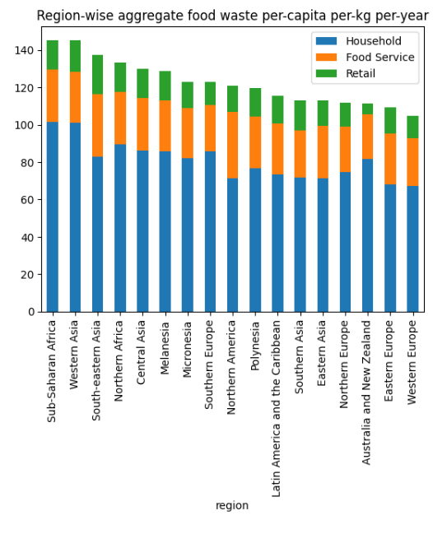

Slide 30
SUMMARY OF FINDINGS:
- Enhanced Inventory Control: Implementing advanced inventory tracking systems significantly reduces overstocking and spoilage.
- Public Awareness Initiatives: Educational campaigns lead to better consumer habits in food storage and portion control.
- Supply Chain Efficiency: Improved coordination between suppliers and retailers decreases waste during transportation and storage.

Slide 31
IMPACT OF PROPOSED SOLUTION:
- Reduction in Waste: Significant decrease in food waste across the supply chain.
- Cost Savings: Lower inventory costs and reduced losses from spoiled goods.
- Consumer Behavior: Enhanced public knowledge leads to better food management practices at home.

Slide 32
FUTURE WORK:
- Continuous Improvement: Regularly update inventory systems and training programs.
- Expanded Campaigns: Broaden the reach of educational initiatives to more communities.
- Technological Integration: Explore emerging technologies like AI and IoT for further optimization of inventory and supply chains.

Slide 33
DATA SOURCES:
Kaggle: Various food waste datasets from Kaggle, including:
- “Food Waste Data”
- “Food Demand Forecasting”
- “Grocery Store Food Waste”

Slide 34





TOOLS AND SOFTWARE USED
PYTHON
TABLEAU
JUPYTER NOTEBOOK
QGIS
MS - EXCEL

